Slide 1
A Tale of Mobile Threats
Vincenzo Iozzo
Director of Security Engineering
Trail of Bits

Slide 2
In which I blame people
Part 1

Slide 3
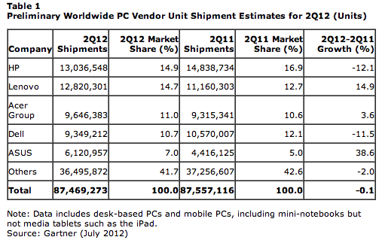
Why mobile?
“Total smartphone sales in 2011 reached 472 million units and accounted for 31 percent of all mobile devices sales, up 58 percent from 2010.” - Gartner
11% increase

Slide 4

That’s how we deal with mobile

Slide 5
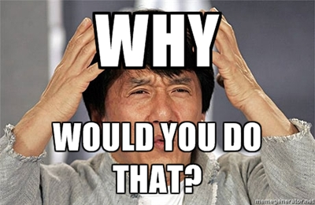

Slide 6
How does offense work?
Attacker’s mindset
Gaining access
Keeping access/stealing data

Slide 7
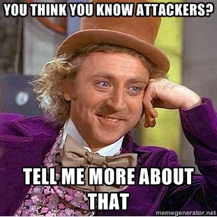
We currently fail badly at the understanding the first two

Slide 8

First problem: spot the difference

Slide 9

Black swans? What’s that?
A very interesting research result that is unlikely to happen in real life

Slide 10
Why black swans exist?
“Machines can remain vulnerable longer than you can remain sane”
The security community is fixated on persistance
A lot of people forget the mantra: “whoever scores is right”
Technical elegance is highly valued

Slide 11

Black swans and attacker math
Attackers are resource-constrained: “The Exploit Intelligence Project” (Dan Guido)
Attackers are rational human beings
Attackers will take a given exploitation path IFF no cheaper paths are available

Slide 12
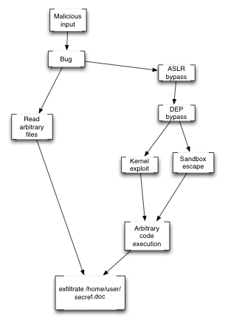
Exploitation paths

Slide 13
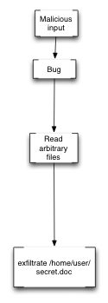
A rational attacker

Slide 14
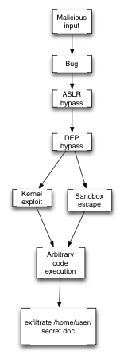
A black swan

Slide 15
Practical example
A rational attacker
A black swan (AKA: are you nuts?)

Slide 16


So…
1
0
VS

Slide 17
Unless..
The ROI on a black swan is higher, for some definition of “return”
Flame md5 collision attack comes to mind
Therefore our graph is weighted

Slide 18
Weight function
That’s very hard to calculate in the general case
Some examples in “Attacker Math 101” (Dino Dai Zovi)
A bit out of scope here
But we can usually draw a line easily

Slide 19
What if two paths are equally cost effective?

Slide 20
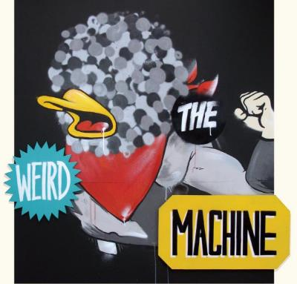
Gaining access..
It’s all about programming a “weird machine” (Sergey Bratus et al.)

Slide 21

The weird machine
In short: “a machine that executes an unexpected series of instructions”

Slide 22
By examples
ROP
JIT Spraying – Dion Blazakis
SpiderMonkey Bytecode Hijacking – Thomas Dullien
JIT code hijacking – Chris Rohlf and Yan Ivnitskiy
…

Slide 23
Exploitation
Exploitation is setting up, instantiating, and programming the weird machine - Thomas Dullien

Slide 24
Controlling the machine
You need write primitives
You need infoleaks/memleaks
For both you need some degree of control over the application.
It’s either pure data or you can directly influence the application state (eg: through an interpreter of some kind)

Slide 25
Controlling the machine 2
Just data = most likely you need multiple bugs (infoleak, write primitive, etc)
Through interpreter = most likely you just need one (see comex jailbreaks for example)

Slide 26
Me no like exploits
This process is challenged in a few ways:
Negate the initialization (fix bugs)
Make the setup hard (heap/stack mitigations, ASLR)
Make it hard to put together ‘weird instructions’ (ASLR, DEP, JIT hardening)
Reduce/Neutralize the effects of a running weird machine (sandboxing, code signing)
More to come in the future..

Slide 27
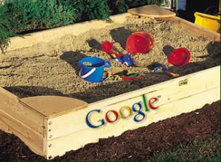

Get to the data/persistence
How hard is to get your code on a target?
How far away is the data you care for from you?

Slide 28
For future reference..
So here’s the thing:
In a few years everything an attacker cares for will be inside a browser/mobile app
Do sandboxes help with that? *NO*

Slide 29
Let’s wrap up
Attacker’s mindset: take the most cost-effective path
When it comes to exploitation the most cost-effective path is:
1) As close as possible to your data
2) Reduces as much as possible the need for multiple bugs/exploits
3) Reduces maintenance cost

Slide 30
In which I actually talk about mobile
Part 2

Slide 31

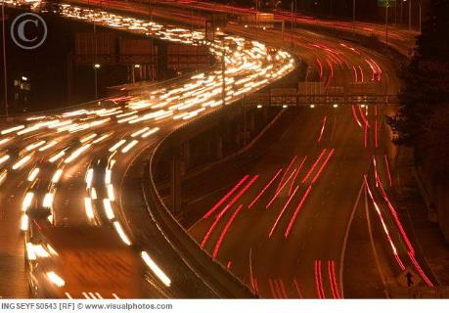
Drive-bys
Mobile Town
Desktop City

Slide 32
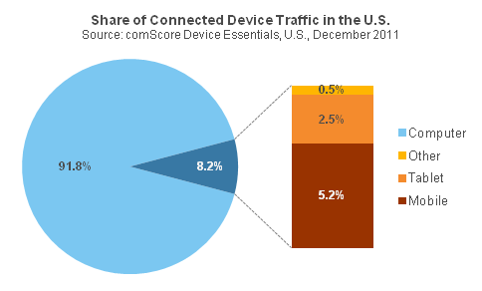
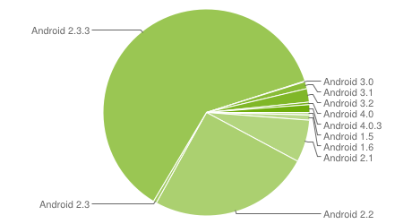
Too few and too many
~8% of total web traffic
comes from mobile devices
Breakdown by version / features
(+ varying rates of feature support)

Slide 33
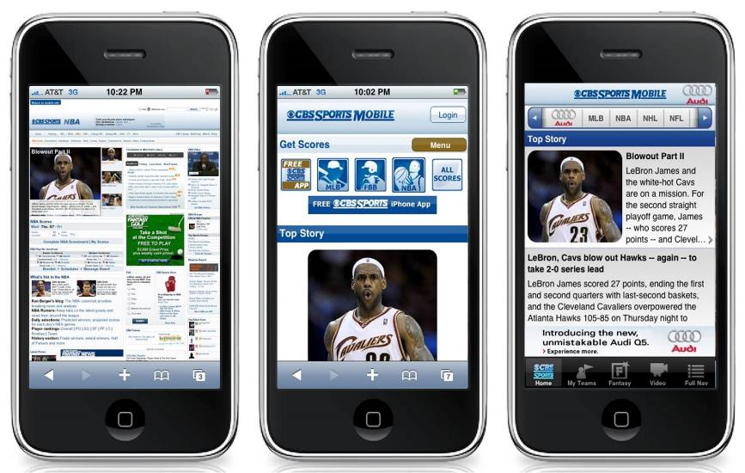
Like Facebook..

Slide 34
Takeaway
Drive-bys don’t matter and realistically never will
Hard to get anything useful (contrary to dekstops) out of them
Hard to run the attack in the first place
The web is the future of the desktop, apps are the future of mobile = attackers behave accordingly

Slide 35
Malware
31
1
Apple App Store
Google Marketplace

Slide 36
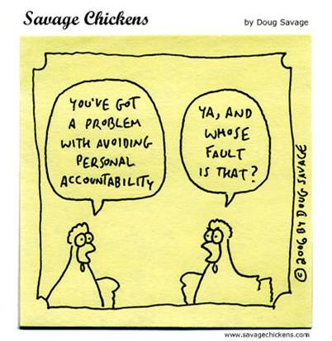
One of the reasons

Slide 37
Malware lasts long on Android
Android Exploit | Time to Patch 50%
Exploid (2.1) | 294 days
RageAgainstTheCage (2.2.1) | > 240 days

Slide 38
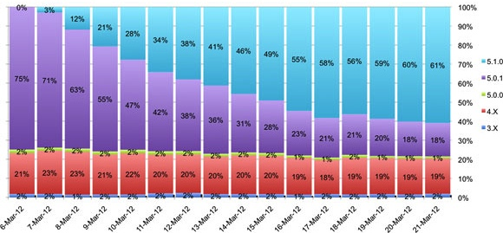
Not so much on iOS
Vulnerability | Exploit | Patch Availability
Malformed CFF | Star (JailbreakMe 2.0) | 10 days
T1 Font Int Overflow | Saffron (JailbreakMe 3.0) | 9 days

Slide 39
AppStore vs Google Play
Apple enforces accountability
Sandbox escape: Android > iOS
Fragmented user-base = the investment lasts
longer
On Android privesc are enough to cause troubles
That being said: jailbroken iOS = Android

Slide 40
Malware - takeaway
Does only matter on Android and jailbroken iOS
It scales, it’s easy and it lasts
Can this be fixed? Yes, Apple did

Slide 41
App specific
Android NDK can open up this attack surface a lot
Interesting because applications are likely less audited than system code
But more importantly: interesting data will be inside the app. Why go anywhere else?
Expect them in the future!

Slide 42
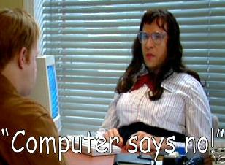
More “smart” in phone?

Slide 43
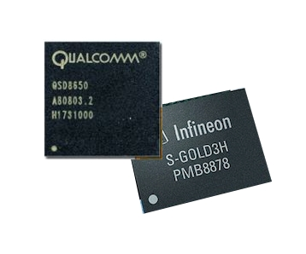
Enter baseband

Slide 44
A few words on it
Most of the code in there is old (1990 old)
Based on the assumption that the actors are trusted
Most of the research has been done by Ralf Philipp Weinmann
His research led to bug fixing and some mitigations

Slide 45
Infrastructure
Separate processor
Customized RTOS
Mostly closed-source
Most of them run on ARM (notable exception Hexagon)
Separated (mostly) from the App processor

Slide 46
Baseband weird machines
Increased attention being paid to bugs in there
Still a very big surface with few (known) actors
Big state machine based on a giant interface, so hard to fuzz
Need profound knowledge to find certain bugs

Slide 47
Baseband weird machine 2
Very few mitigations in place
Still most of the heap metadata exploitation is possible (eg: write4 primitives on Infineon)
No ASLR, no “sandboxes”
Remote: control through data only
Local: “interpreter” (AT commands)

Slide 48
Baseband - persistence
Good luck with forensics/IR
Depending on how the App processor interacts with the BB it might lead to full-device compromise
Regardless: access to phone calls, SMS and data

Slide 49
Attack scenarios
Remote exploit to steal/alter/make sms/data/phone calls
App remote-> BB local rootkit
BB remote -> BB local rootkit
DDos in case of crisis?

Slide 50
So ..
High ROI
Very few mitigations
Detection is hard
Great target for motivated attackers!

Slide 51
NFC
That’s complicated…

Slide 52
NFC - capabilities
Can potentially lead to device compromise through malformed packets at protocol level – device proximity
Can lead to device compromise at ‘application level’ – tag proximity
Steal data – roughly 1.5 meters with custom hardware
Auth bypass issues

Slide 53
First case
Not very viable..
On the flipside, you can potentially get huge access to the device
Most likely a black swan

Slide 54
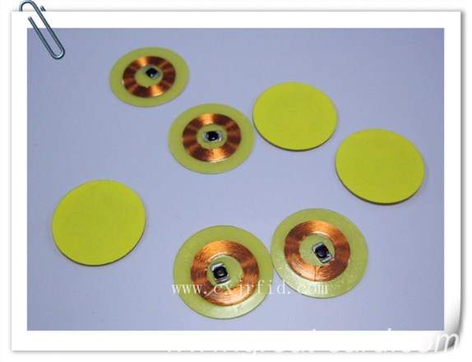
Second case
You can compromise the device by using tags (simple stickers) -> do not need proximity

Slide 55
Second case
You can either run your exploit for browser and stuff (might require some kind of permission)
Compromise through tag parsing!
Mobile Pwn2own 2012 was won using this approach
This is more interesting! Rational black swan

Slide 56
In which I give advices
Part 3

Slide 57
Software vendors
Put in place the mitigations that *matter*
Hire full-time exploit writers (just a few) and design mitigations based on them
Reduce attacker’s control over your product (why does WinRAR need an x86 interpreter?)

Slide 58
Developers
Realize where the important data is and segregate it
I know Java sucks but don’t write your own C/C++ service for your Android app

Slide 59
Policy makers
Plan for the threats that are hard to spot (eg: baseband). Enforce encryption for company data on employees devices
Do not allow jailbreaks of any kind
Segregate mobile devices from the rest of your company network (treat them as “untrusted”)

Slide 60
In which I make provocative statements
Part 4

Slide 61
Conclusion
If you don’t know *what* you’re protecting, you’ll fail
Likewise if you don’t know what you’re protecting *against*, you’ll fail
You don’t need a horde of code auditors & policy people, you need a CEO (chief exploitation officer)

Slide 62
Specific to mobile
Worry more about the “phone” than the “computer”
App sandboxes are great to make persistence hard, way less so for data exfiltration
Android is bad, you don’t want that in your company
NFC is/will be more a “physical” security issue than an Infosec one

Slide 63
In which you can ask questions or insult me
Part 5

Slide 64
Thanks! Questions?
vincenzo@trailofbits.com

